Slide 1
Improving Data infrastructure how it affect data driven analysis

Slide 2
Architecture

Slide 3
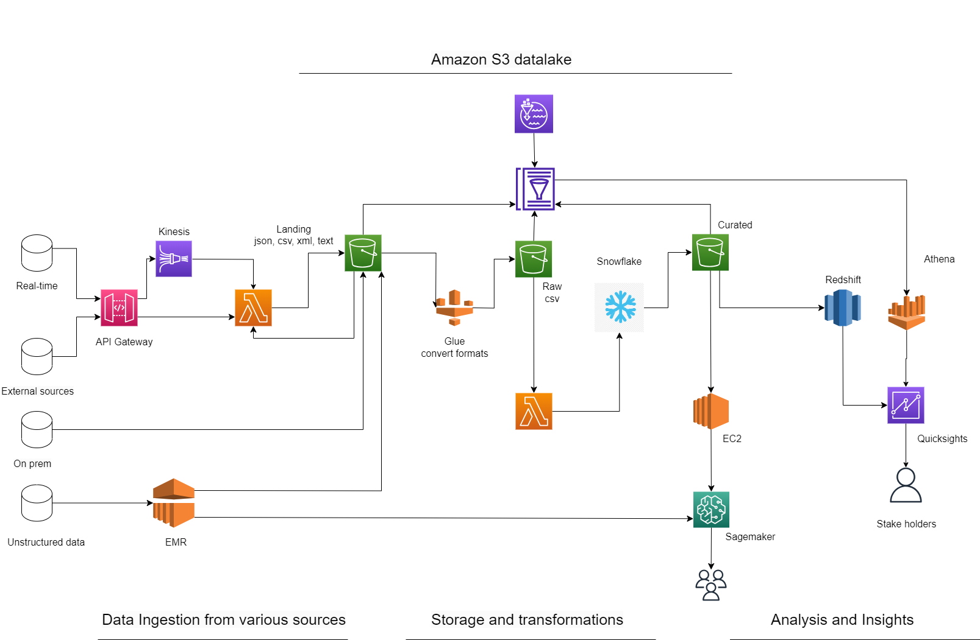

Slide 4
Data and Tables: Simmons Bank Anywhere API
Customer Data: Banks collect and maintain extensive customer data, including personal information (such as name, address, contact details), identification documents, transaction history, account balances, credit history, loan applications, and other financial details.
Transaction Data: Banks process and store transaction data generated by customers' financial activities, such as deposits, withdrawals, fund transfers, credit card transactions, loan repayments, and investment transactions. Transaction data provides insights into customers' spending patterns, income streams, and financial behavior.
Credit Bureaus: Banks often rely on credit bureaus to access credit reports and credit scores of individuals and businesses. These bureaus maintain comprehensive databases of credit information, including payment histories, outstanding debts, bankruptcies, and other relevant financial data. Banks use this information to assess creditworthiness and make lending decisions.
https://developer.equifax.com/
CustomerID, Name, Address, ContactNumber, Email, DateOfBirth, SocialSecurityNumber, IdentificationType, IdentificationNumber, AccountNumber, AccountType, AccountBalance, CreditScore, LoanApplicationDate, LoanAmount, EmploymentStatus
TransactionID, CustomerID, TransactionDate, TransactionType, Amount, Currency, SourceAccount, DestinationAccount, MerchantName, TransactionDescription
CustomerID, CreditReportID, CreditScore, PaymentHistory, OutstandingDebt, BankruptcyStatus, CreditLimit, CreditUtilization, CreditInquiries

Slide 5
Data and Tables: Simmons Bank Anywhere API
Market Data: Banks monitor market data to gain insights into economic conditions, interest rates, foreign exchange rates, commodity prices, stock market movements, and other financial indicators.
Refinitiv (https://www.refinitiv.com/)
Regulatory Data: This includes transaction monitoring and reporting to detect and prevent money laundering, fraud, and other financial crimes.
Date, EconomicIndicators, InterestRate, ExchangeRate, CommodityPrice, StockMarketIndex
TransactionID, CustomerID, TransactionDate, TransactionAmount, TransactionType, SuspiciousActivityFlag, AMLFlag, FraudFlag, InvestigationStatus

Slide 6
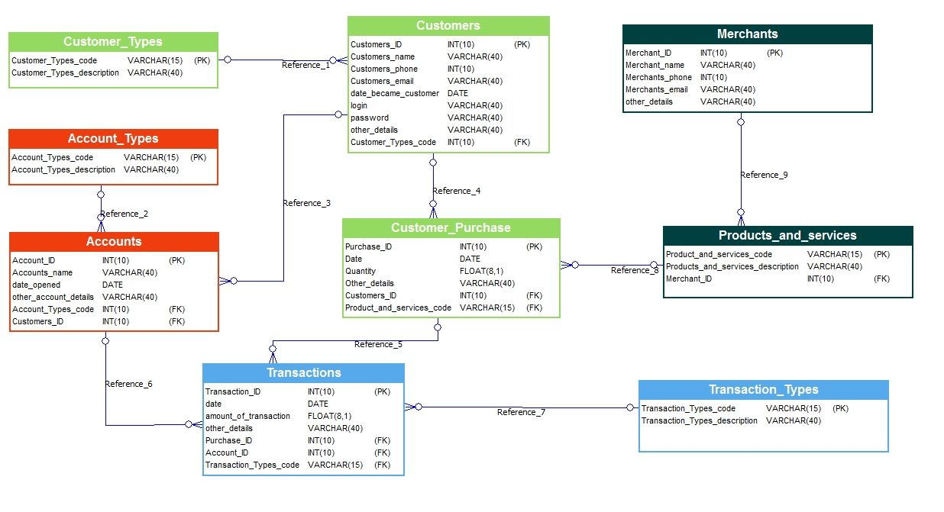

Slide 7
AWS CLI for on prem to cloud
File Division: With a multipart upload, you break the large object into smaller parts, or "chunks." These chunks can be of varying sizes, except for the last part, which can be smaller if the object size is not perfectly divisible by the chunk size.
Resumable and Fault Tolerant: If any part of the upload fails, you only need to re-upload that specific part, rather than starting the entire upload process from scratch. This resumable nature of multipart uploads enhances fault tolerance, as failures in individual parts do not affect the entire upload.
aws s3 cp <local-file> s3://<bucket-name>/<object-key> --recursive --multipart-upload

Slide 8
Why glue catalog for Athena?
Schema Discovery: The Glue crawler feature automatically discovers the schema and structure of your data sources, such as data stored in Amazon S3. It can infer table definitions, column names, data types, and other metadata, saving you the effort of defining them manually.
Data Catalog Updates: As your data sources evolve and change over time, you can update the metadata in the Glue Data Catalog to reflect those changes. Athena will automatically use the updated metadata for query execution, ensuring that you're always working with the most up-to-date information.
Data Partitioning: a technique to organize large datasets into smaller, more manageable partitions based on specific criteria (e.g., date, region, category). Partitioning improves query performance by allowing Athena to scan only the relevant partitions when executing queries.

